Slide 1



JAVA-BASED ENTERPRISE INVENTORY MANAGEMENT SYSTEM
Project Code: #z-13-18
Presented by:
Sagar & Team
Batch- 13

Slide 2

Table of Content
Introduction
Project Objective
System Architecture
System Architecture
Technology Stack
System Modules
Database Design
Key Features
Conclusion
Team
Thanks note

Slide 3
Introduction
Inventory management is a key part of business operations that ensures products are available in the right quantity at the right time. Proper inventory control helps businesses reduce operational costs, avoid stock shortages, and improve customer satisfaction.
However, many small and medium businesses still rely on manual inventory tracking methods, which create several challenges.
Challenges of manual inventory systems:
High chances of human errors
Delayed updates of stock information
Difficulty in tracking real-time inventory levels
Limited ability to generate accurate reports
To solve these issues, businesses require an automated inventory management system.
Benefits of an automated system:
Real-time inventory tracking
Automated stock updates
Reporting and analytics for decision-making
Low-stock alerts to prevent shortages
Such systems improve efficiency, reduce manual effort, and enable better inventory management.

Slide 4


Project Objective
1.Automate Inventory Tracking
Develop a system to efficiently manage and update product stock levels in real time.
2.Implement Secure User Access
Provide role-based authentication (Admin/User) to ensure secure access and controlled inventory operations.
3.Generate Inventory Reports
Enable generation and export of inventory data such as stock details and summaries for analysis.
4.Monitor Stock Levels and Alerts
Detect low-stock products and notify users to maintain optimal inventory levels and prevent shortages.

Slide 5

System Architecture
The Inventory Management System follows a layered architecture, where each layer is responsible for a specific function. This structure improves code organization, maintainability, and scalability. Data flows from the user interface to the database through different layers, each handling a particular task in the system.
1. User Interface (Frontend)
Built using HTML, CSS, Bootstrap, and Thymeleaf
Provides pages like Login, Dashboard, and Product Management
Enables user interaction with the system
2. Controller Layer
Handles HTTP requests and responses
Connects frontend with backend logic
Implemented using Spring Boot Controllers
3. Service Layer
Contains business logic
Manages product operations, stock updates, and inventory calculations
4. Repository Layer
Handles database interactions
Uses Spring Data JPA for CRUD operations
5. Database Layer
Stores users, products, and inventory data
Implemented using MySQL

Slide 6
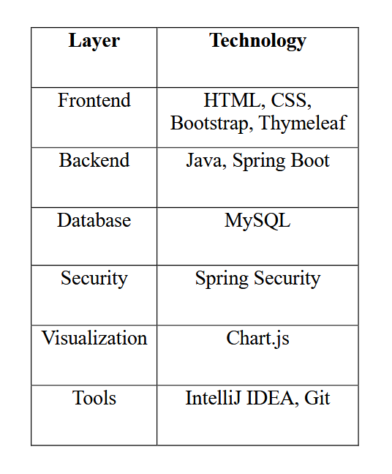
Technology Stack

Slide 7
System Modules
1. Inventory Tracking Engine
Manages core inventory operations such as adding products, updating stock levels, and viewing product details. It ensures accurate tracking of inventory data.
2. User Authentication System
Provides secure login and role-based access control to ensure that only authorized users can manage or modify inventory information.
3. Reporting and CSV Integration
Generates inventory reports and summaries and allows exporting data into CSV files for analysis and record-keeping.
4. Stock Alert System
Monitors inventory levels and detects low-stock products, helping users reorder items on time and avoid shortages.

Slide 8
Database Design
🗂️ Tables Overview
The system is designed using three core tables to manage products, track stock changes, and handle users:
Products Table
Stores product details such as name, category, price, quantity, reorder level
Maintains last_updated timestamp for real-time tracking
Primary Key: id
Stock_Logs Table
Records every stock movement (ADD / REMOVE)
Tracks change date, product reference, and quantity changed
Primary Key: id
Foreign Key: product_id → Products.id
Users Table
Manages system users with roles (ADMIN / USER)
Stores username, email, encrypted password
Includes enabled flag for account activation
Primary Key: id

Slide 9

Key Features
User Login & Signup
Role-based access (Admin/User)
Add / Update products
Stock update system
Low stock alerts
Dashboard analytics
Graph visualization
CSV export reports
Search and filtering

Slide 10
Conclusion
1.Developed a Java-based inventory management system that automates product tracking, secure authentication, and real-time stock monitoring.
2.Replaces manual inventory methods, reducing errors and improving operational efficiency through features like stock alerts, reporting, and role-based access.
3.Built with a modular design, allowing future enhancements such as email notifications, advanced analytics, and cloud deployment.

Slide 11

OUR TEAM
Sagar Wankhede
Sumit Kumar
RathiKindi Meenakshi
Swetha A

Slide 12
THANK YOU

